Slide 1
MISS AMERICA WELCOME EVENT
Miss America 2022
EMMA BROYLES
SEPTEMBER 16, 2022

Slide 2
Emma Broyles Miss America 2022 Advocate I Vocalist | Student

Slide 3
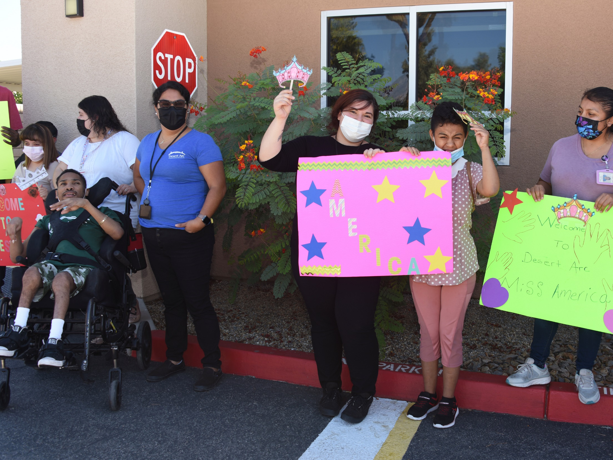

Slide 6
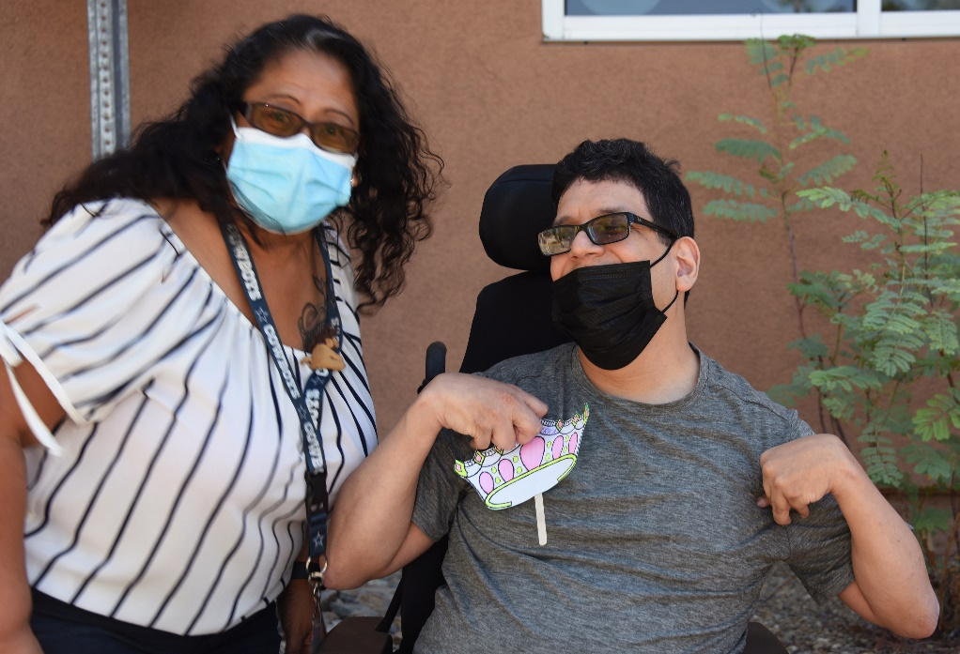
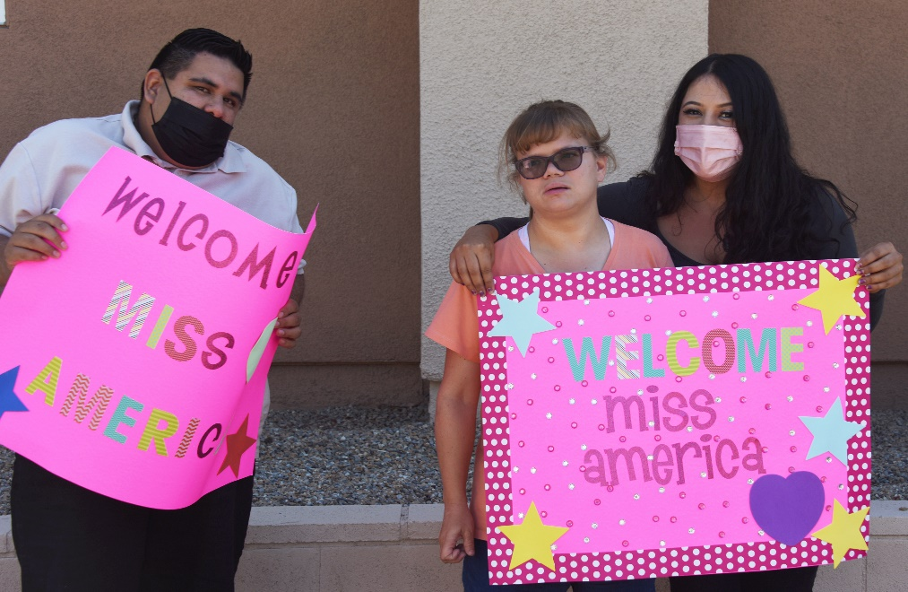
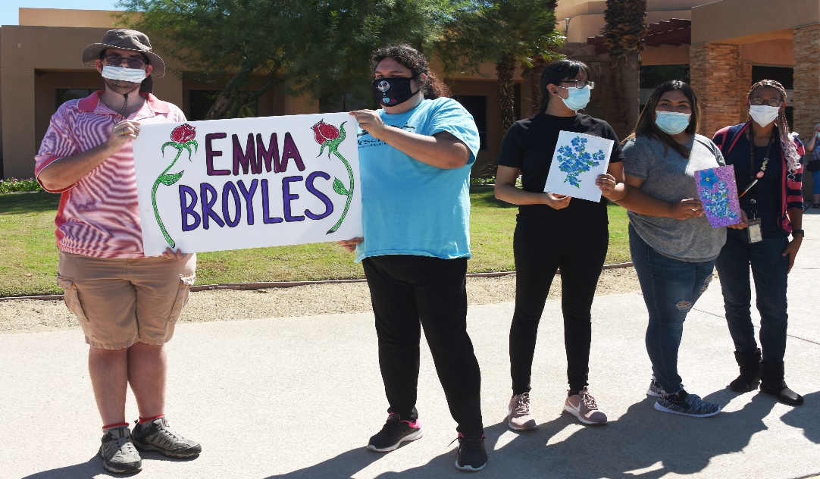

Slide 7
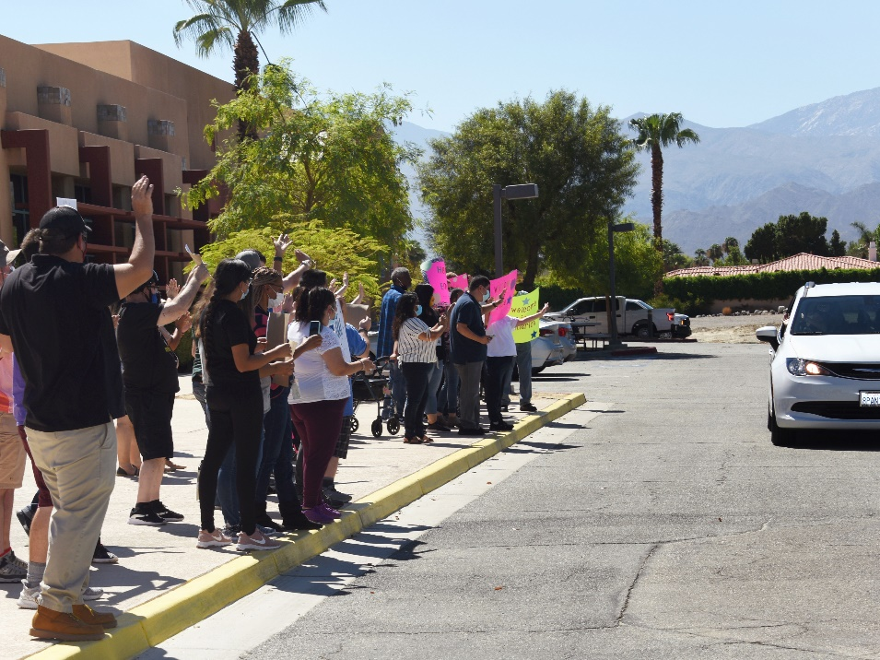
WELCOME
MISS AMERICA
PALM DESERT CAMPUS

Slide 8
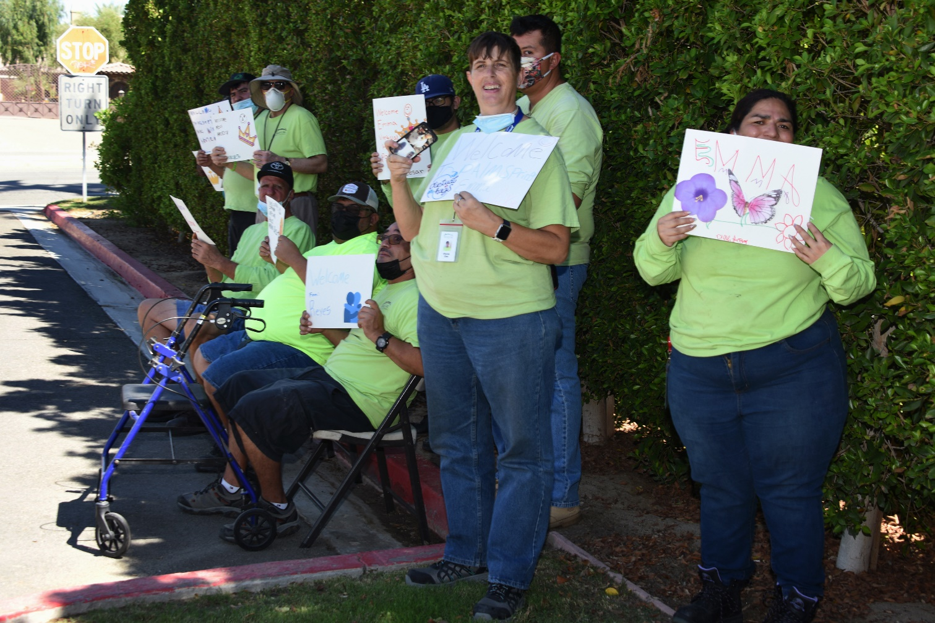
WELCOME
CLIENTS FROM THE RECYCLING CENTER
Came By Bus From Indio To Greet Miss America

Slide 9
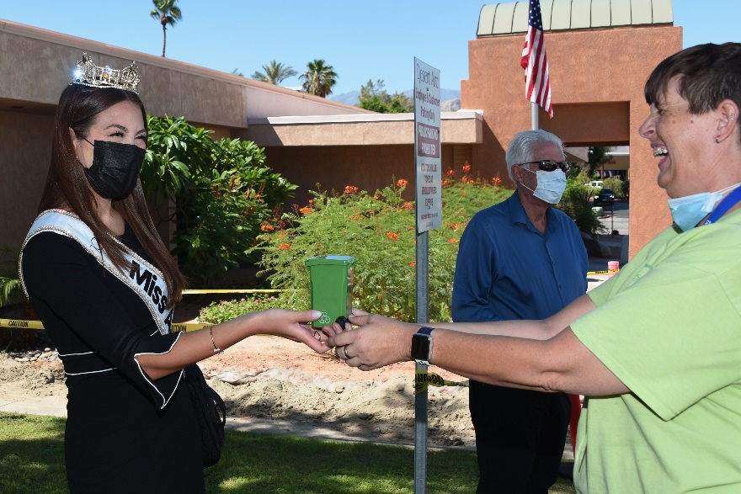
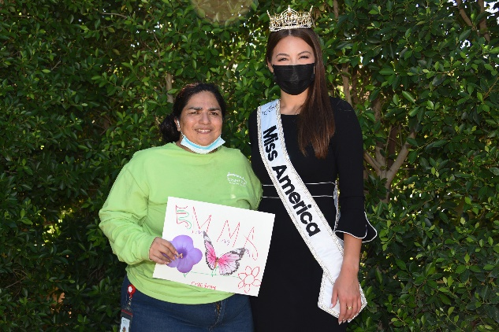
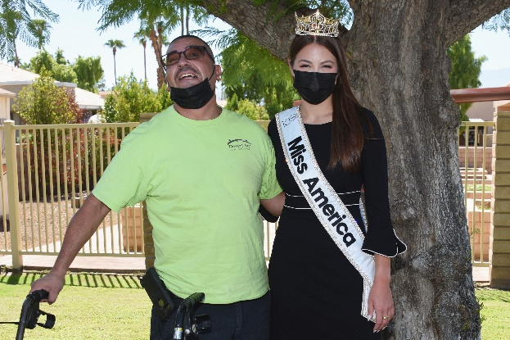
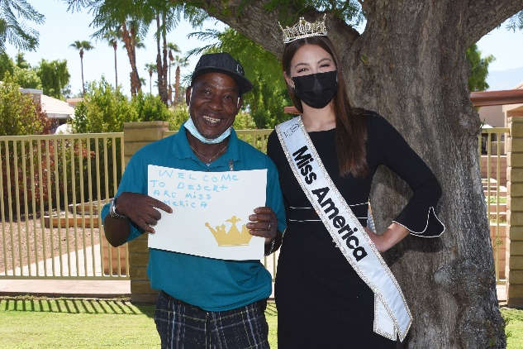
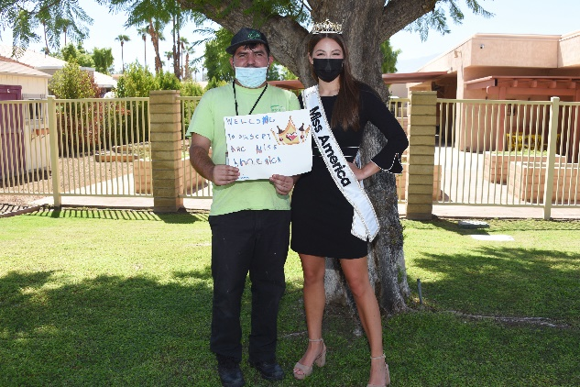

Slide 10
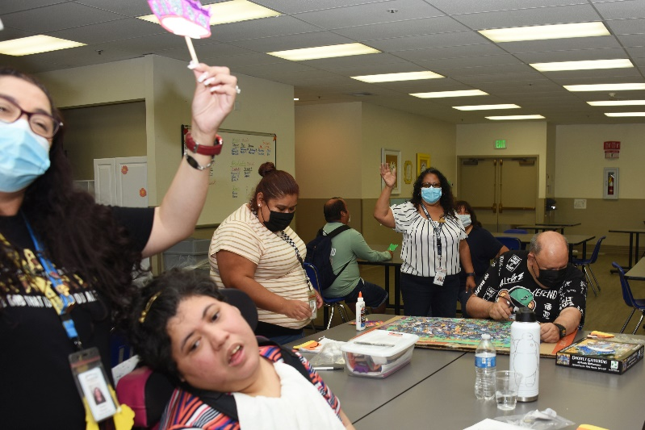
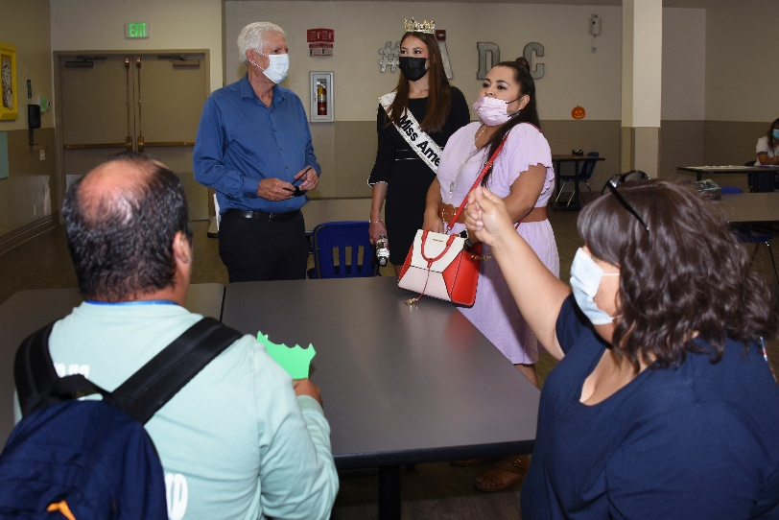
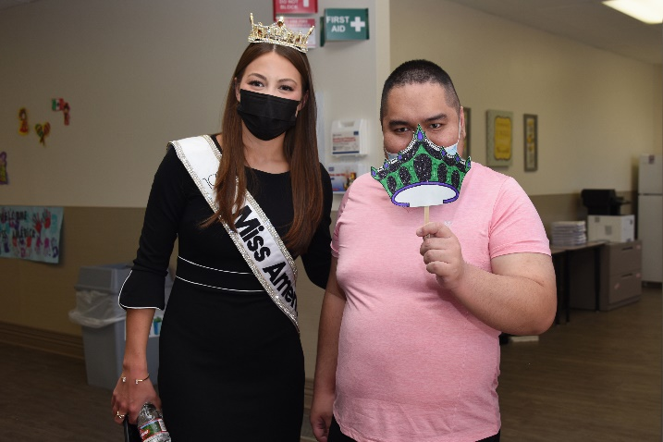
BUILDING 1
Adult Day Program
Cafeteria Services

Slide 11
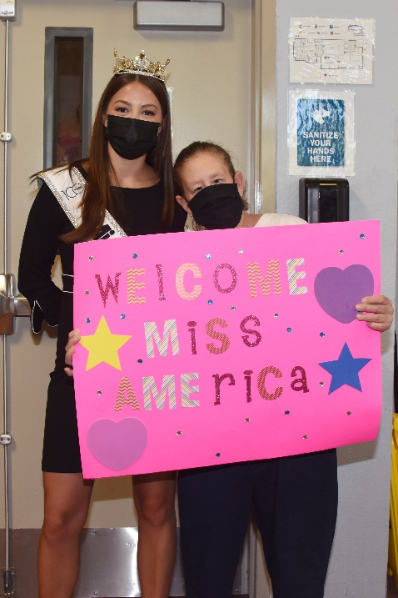
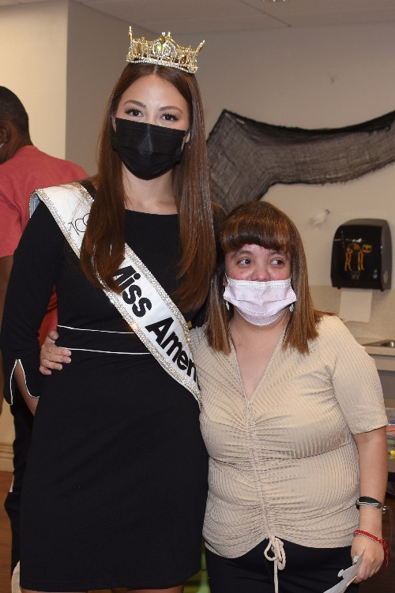
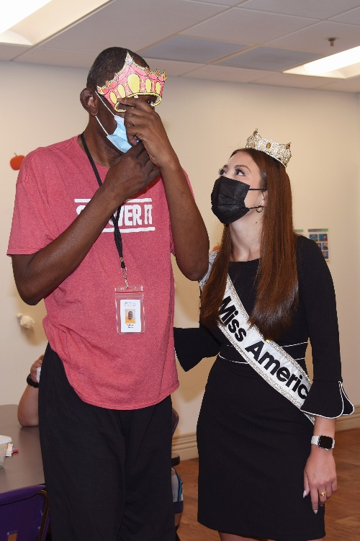
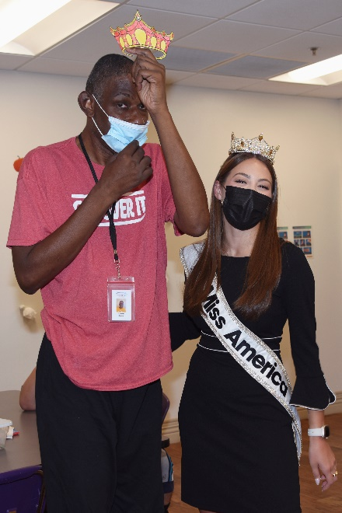
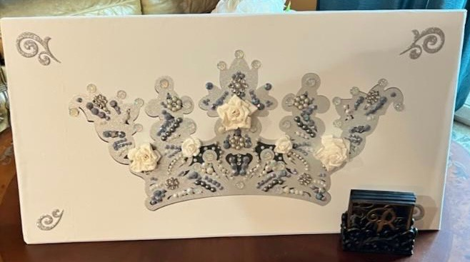
BUILDING 2
Adult Day Program
CROWN THANK YOU CARD
Designed by Clients

Slide 12
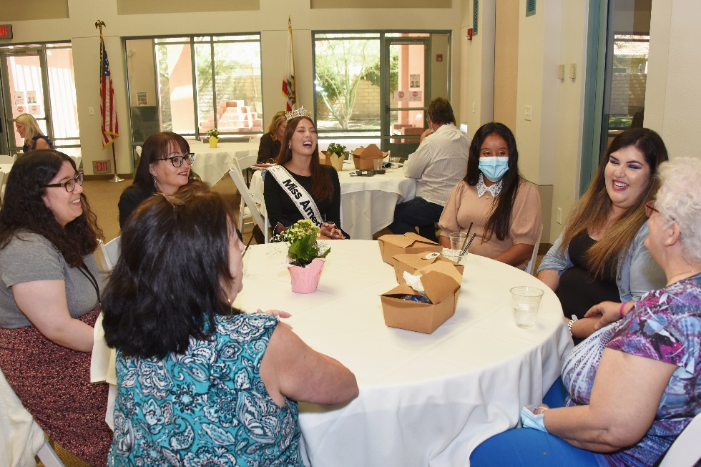
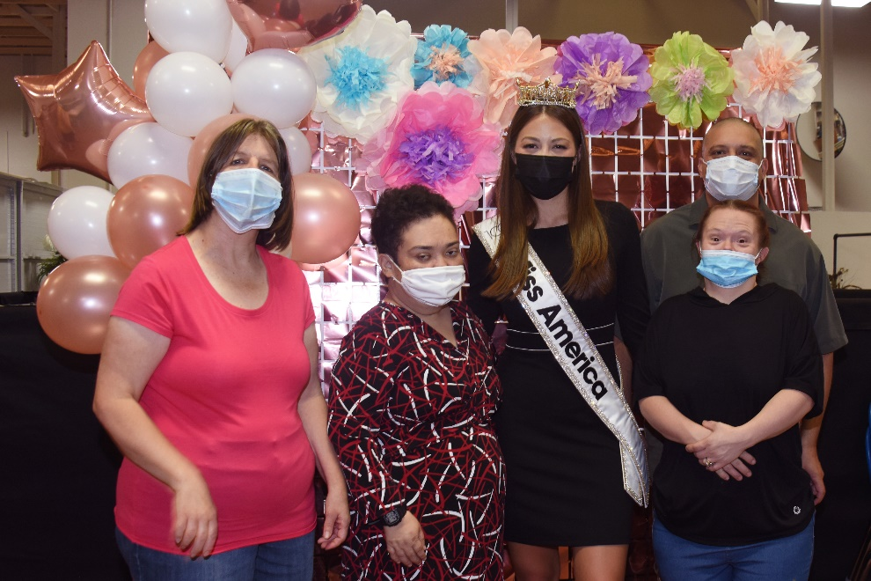
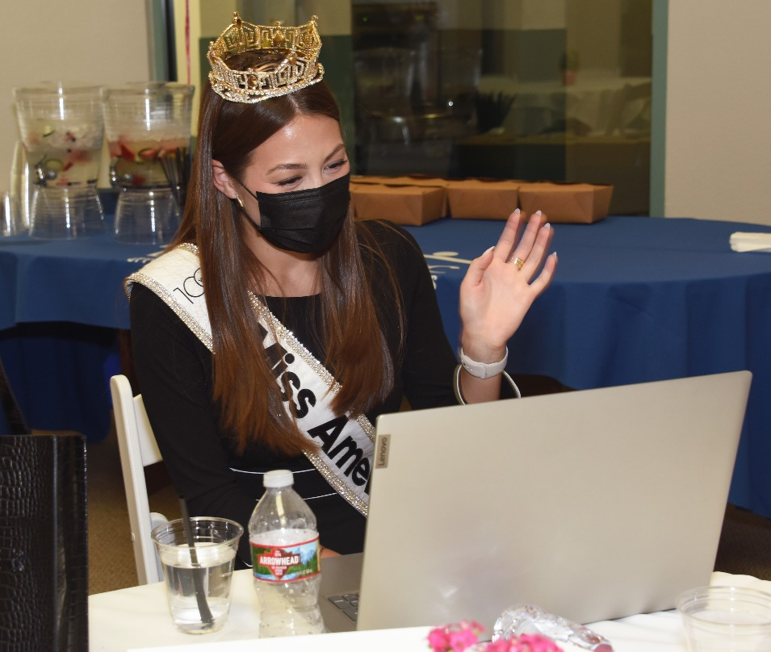
BUILDING 3
FYI – For Your Independence
Yucca Valley – Work Activity
and Clients Virtually on Zoom

Slide 13
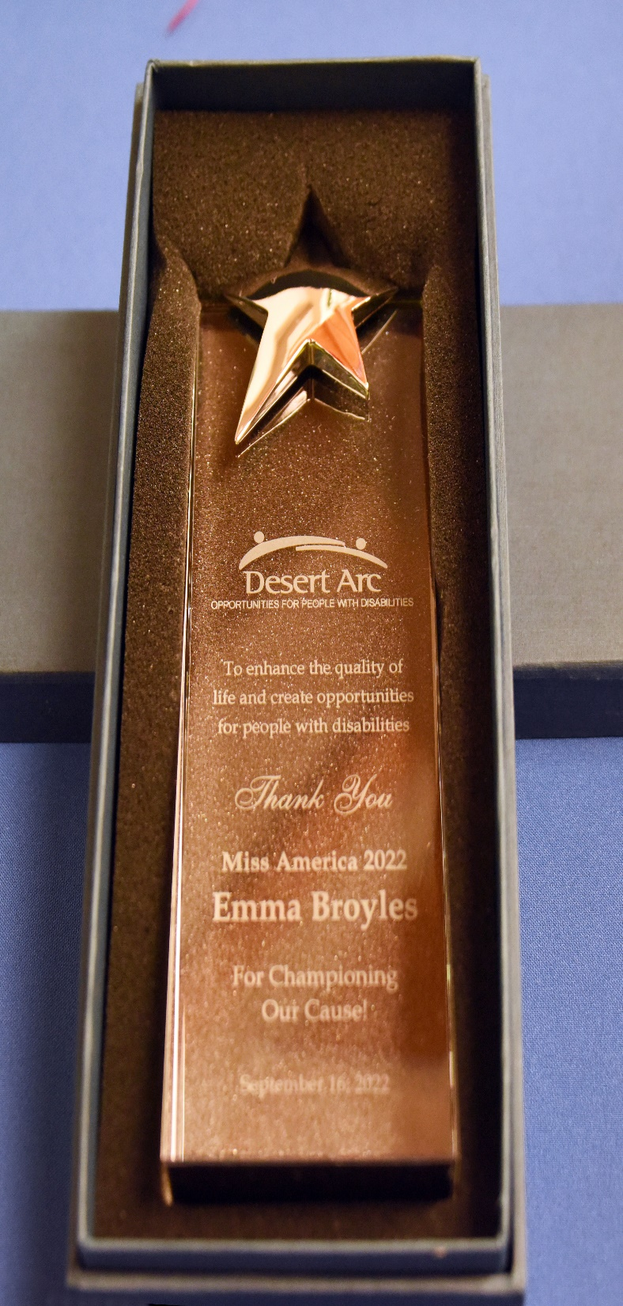
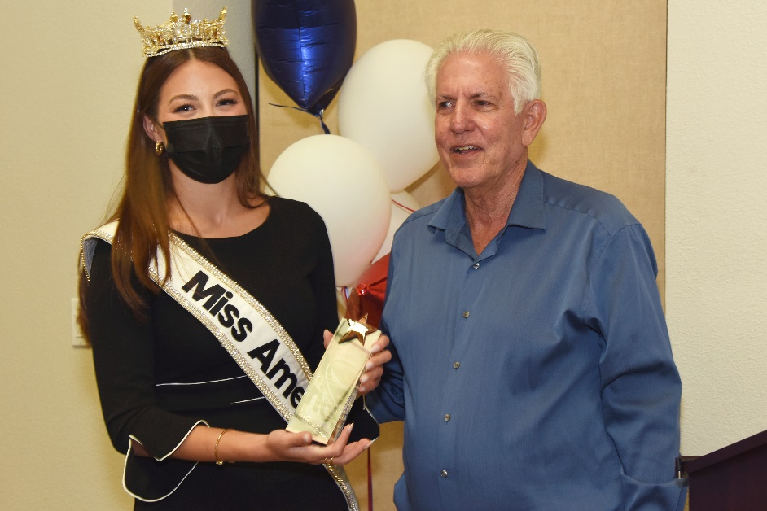
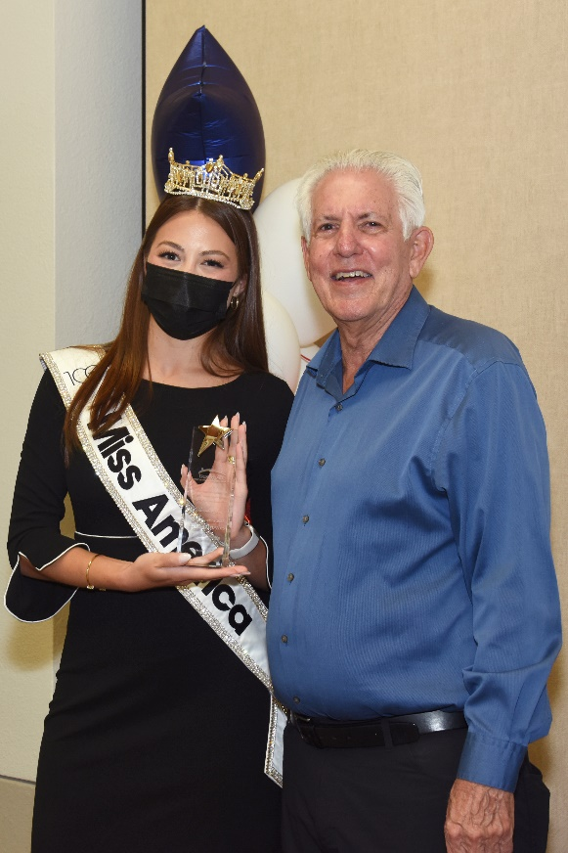

Slide 14
THANK YOU
Desert Arc Team and Welcome Entourage

Slide 15
THANK YOU
MISS AMERICA

